Slide 1
A First Look at the Decision Tree Classifiers

Slide 2
Introduction
Decision tree learning is one of the most widely used techniques for classification.
Its classification accuracy is competitive with other methods, and
it is very efficient.
The classification model is a tree, called decision tree.
C4.5 by Ross Quinlan is perhaps the best known system and the codes are freelly available from internet.

Slide 3
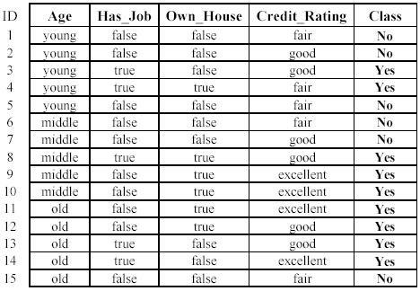
The loan data (reproduced)
Approved or not

Slide 4
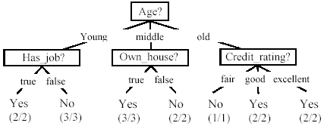
A decision tree from the loan data
Decision nodes and leaf nodes (classes)

Slide 5

Use the decision tree
No

Slide 6
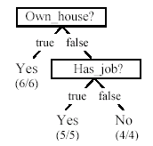
Is the decision tree unique?
No. Here is a simpler tree.
We want smaller tree and accurate tree.
Easy to understand and perform better.
Finding the best tree is NP-hard.
All current tree building algorithms are heuristic algorithms

Slide 7


From a decision tree to a set of rules
A decision tree can be converted to a set of rules
Each path from the root to a leaf is a rule.

Slide 8
Algorithm for decision tree learning
Basic algorithm (a greedy divide-and-conquer algorithm)
Assume attributes are categorical now (continuous attributes can be handled too)
Tree is constructed in a top-down recursive manner
At start, all the training examples are at the root
Examples are partitioned recursively based on selected attributes
Attributes are selected on the basis of an impurity function (e.g., information gain)
Conditions for stopping partitioning
All examples for a given node belong to the same class
There are no remaining attributes for further partitioning – majority class is the leaf
There are no examples left

Slide 9
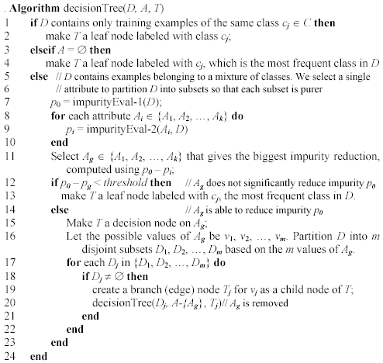
Decision tree learning algorithm

Slide 10
Choose an attribute to partition data
The key to building a decision tree - which attribute to choose in order to branch.
The objective is to reduce impurity or uncertainty in data as much as possible.
A subset of data is pure if all instances belong to the same class.
The heuristic in C4.5 is to choose the attribute with the maximum Information Gain or Gain Ratio based on information theory.

Slide 11
The loan data (reproduced)
Approved or not

Slide 12
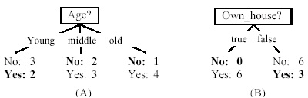
Two possible roots, which is better?
Fig. (B) seems to be better.

Slide 13
Information theory
Information theory provides a mathematical basis for measuring the information content.
To understand the notion of information, think about it as providing the answer to a question, for example, whether a coin will come up heads.
If one already has a good guess about the answer, then the actual answer is less informative.
If one already knows that the coin is rigged so that it will come with heads with probability 0.99, then a message (advanced information) about the actual outcome of a flip is worth less than it would be for a honest coin (50-50).

Slide 14
Information theory (cont …)
For a fair (honest) coin, you have no information, and you are willing to pay more (say in terms of $) for advanced information - less you know, the more valuable the information.
Information theory uses this same intuition, but instead of measuring the value for information in dollars, it measures information contents in bits.
One bit of information is enough to answer a yes/no question about which one has no idea, such as the flip of a fair coin

Slide 15
Information theory: Entropy measure
The entropy formula,
Pr(c_{j}) is the probability of class c_{j} in data set D
We use entropy as a measure of impurity or disorder of data set D. (Or, a measure of information in a tree)

Slide 16
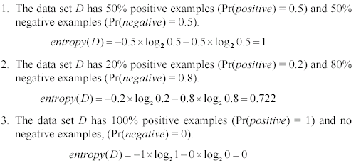
Entropy measure: let us get a feeling
As the data become purer and purer, the entropy value becomes smaller and smaller. This is useful to us!

Slide 17

Information gain
Given a set of examples D, we first compute its entropy:
If we make attribute A_{i}, with v values, the root of the current tree, this will partition D into v subsets D₁, D₂ …, D_{v} . The expected entropy if A_{i} is used as the current root:

Slide 18
Information gain (cont …)
Information gained by selecting attribute A_{i} to branch or to partition the data is
We choose the attribute with the highest gain to branch/split the current tree.

Slide 19
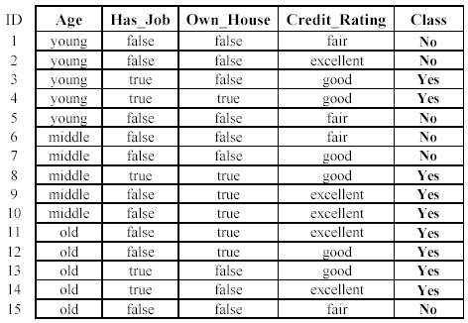

An example
Own_house is the best choice for the root.

Slide 20
We build the final tree
We can use information gain ratio to evaluate the impurity as well

Slide 21
Handling continuous attributes
Handle continuous attribute by splitting into two intervals (can be more) at each node.
How to find the best threshold to divide?
Use information gain or gain ratio again
Sort all the values of an continuous attribute in increasing order {v₁, v₂, …, v_{r}},
One possible threshold between two adjacent values v_{i} and v_{i+1}. Try all possible thresholds and find the one that maximizes the gain (or gain ratio).

Slide 22
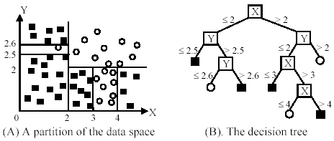
An example in a continuous space

Slide 23
Avoid overfitting in classification
Overfitting: A tree may overfit the training data
Good accuracy on training data but poor on test data
Symptoms: tree too deep and too many branches, some may reflect anomalies due to noise or outliers
Two approaches to avoid overfitting
Pre-pruning: Halt tree construction early
Difficult to decide because we do not know what may happen subsequently if we keep growing the tree.
Post-pruning: Remove branches or sub-trees from a “fully grown” tree.
This method is commonly used. C4.5 uses a statistical method to estimates the errors at each node for pruning.
A validation set may be used for pruning as well.

Slide 24
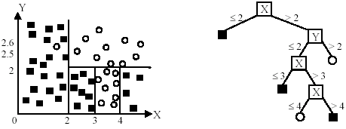
An example
Likely to overfit the data

Slide 25
Other issues in decision tree learning
From tree to rules, and rule pruning
Handling of miss values
Handing skewed distributions
Handling attributes and classes with different costs.
Attribute construction
Etc.

